Slide 1
Git concepts
Viviane and Dag

Slide 2
Git = version control program
Ability to go back to older versions
Ability to combine different people’s versions to a new version
Safe storage ‘in the cloud’ – for instance (but not necessarily) Github
Access for everybody else (in NIVA or in the world) to your scripts/results

Slide 3
Which problems are version control meant to resolve?
Manuscript_1.docx
Manuscript_Final.docx
Manuscript_Final.docx
Manuscript_Final_DHJ.docx
Manuscript_Final_DHJ_MSC.docx
Manuscript_Final_DHJ_MSC_SIX.docx
Manuscript_Final_ELU.docx
Manuscript_Final_ELU_MGR.docx
Manuscript_Final_DHJ_MSC_ANS.docx
Manuscript_Really_final.docx
Manuscript_Really_final_MCS.docx
Etc…..

Slide 4
Git concepts
(= REPO)
WORKSPACE
LOCAL REPOSITORY
REMOTE REPOSITORY
Folder on your computer
Hidden folder on your computer
Github
COMMIT
Script 1
Script 1
PUSH
Script 1
DIFF
Script 2
Script 2
Script 2
PULL
Script 3
Script 3
Script 3
HISTORY or LOG (list of your commits, i.e. versions of your files)
First COMMIT
Last COMMIT (= HEAD)

Slide 5
Git concepts: add your change to your repo
Looks complex - but is very easy in RStudio
WORKSPACE
LOCAL REPOSITORY
REMOTE REPOSITORY
STAGING AREA (= INDEX)
Folder on your computer
Hidden folder on your computer
Github
Changes ready to be committed
Script 1
STAGE (= ADD)
COMMIT
Script 1
Script 1
CHANGE
PUSH
Script 2
Script 2
Script 2
DIFF
Script 3
Script 3
Script 3
New commit added to your history
COMMIT adds a new commit (version) here
PUSH adds a new commit (version) here
Note: changes in more than one file can be committed at once

Slide 6
Git concepts: get your colleague’s change
WORKSPACE
LOCAL REPOSITORY
REMOTE REPOSITORY
Folder on your computer
Hidden folder on your computer
Github
Script 1
Script 1
Script 1
PULL
Script 2
Script 2
Script 2
CHANGE
Script 3
MERGE
Script 3
FETCH
Script 3
Git tries to automatically merge both versions (if it fails → MERGE CONFLICT
PULL gets the latest commit in the remote repository PULL = FETCH first, followed by MERGE Other operations changing workspace: REVERT, RESET, CHECKOUT….
Command-line Git 😲

Slide 7
Git concepts: get an entire project/folder
WORKSPACE
LOCAL REPOSITORY
REMOTE REPOSITORY
NEW
NEW
Folder on your computer
Hidden folder on your computer
Github
Script 1
Script 1
Script 1
Script 2
Script 2
Script 2
CLONE
Script 3
Script 3
Script 3
Creates new folder from scratch, including all files
Creates local repo
CLONE gets an entire repository from Github and copies it to your computer

Slide 8
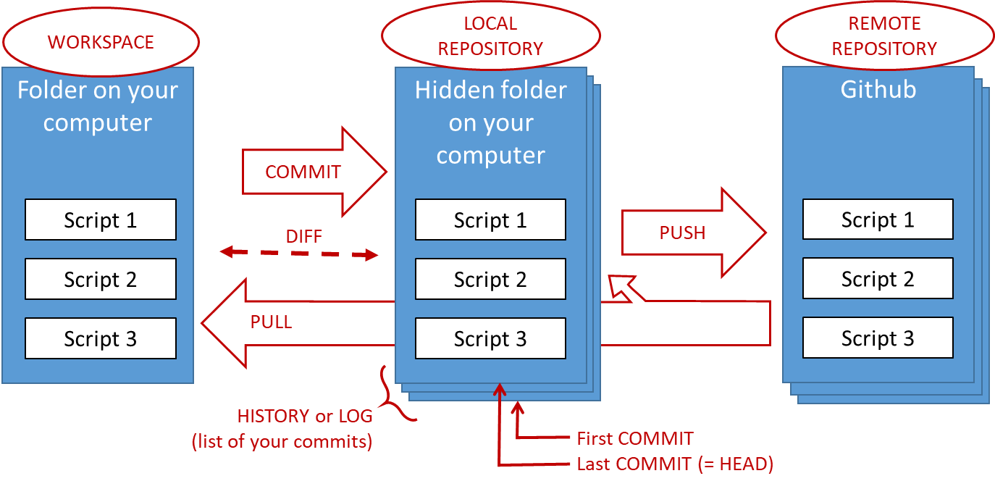
Git concepts: history
Local repository
Remote repository
Workspace
Current state of your files
Commit no. 3
Commit no. 3
Commit no. 2
Commit no. 2
Commit no. 1
Commit no. 1
More common metaphor of history: Each commit is a box, containing a snapshot of all the files (conceptually *)
Metaphor of history used until now: stack of pancakes, with the latest on the top
* Git doesn’t actually store an entire copy of each file, but that is how it appears to us

Slide 9
Git concepts: commiting your changes
1
2
Workspace
Remote repository
Workspace
Remote repository
Local repository
Local repository
New state (one/more files changed)
Starting state of your files
Commit no. 1
Commit no. 1
Commit no. 1
Commit no. 1
3
4
Workspace
Remote repository
Workspace
Remote repository
Local repository
Local repository
New state (one/more files changed)
Commit no. 2
New state (one/more files changed)
Commit no. 2
Commit no. 2
Push
Stage and commit
Commit no. 1
Commit no. 1
Commit no. 1
Commit no. 1

Slide 10
Git concepts: pull your colleague’s changes
1
2
Workspace
Remote repository
Workspace
Remote repository
Local repository
Local repository
Your colleague has made changes and pushed to Github
Commit no. 2
Starting state of your files
Commit no. 1
Commit no. 1
Starting state of your files
Commit no. 1
Commit no. 1
3
Alternative to 3 (instead of pull)
Workspace
Remote repository
Local repository
New state (one/more files changed)
Commit no. 2
Commit no. 2
New state (one/more files changed)
Commit no. 2
Commit no. 2
Fetch
Pull updates both your local repo and your files
Merge
Commit no. 1
Commit no. 1
Commit no. 1
Commit no. 1
Split the pull into two steps

Slide 11
Commit often, push less often
Local repository
Remote repository
Workspace
Current state of your files
Commit no. 4
- It’s ok to have several unpushed commits
- If you mess up, sorting out problems is easier if changes haven’t been pushed
Commit no. 3
Each commit should be possible to describe in one short line
Commit no. 2
Commit no. 2
Commit no. 1
Commit no. 1

Slide 12
Git concepts: commit often, push less often
Local repository
How this is shown in RStudio
Remote repository
Workspace
Current state of your files
Commit no. 4
You can have several unpushed commits
Commit no. 4
HEAD
Commit no. 3
Commit no. 3
Each commit should be possible to describe in one short line (the commit message)
Commit no. 2
Commit no. 2
Commit no. 2
master
Commit no. 1
Commit no. 1
Commit no. 1

Slide 13
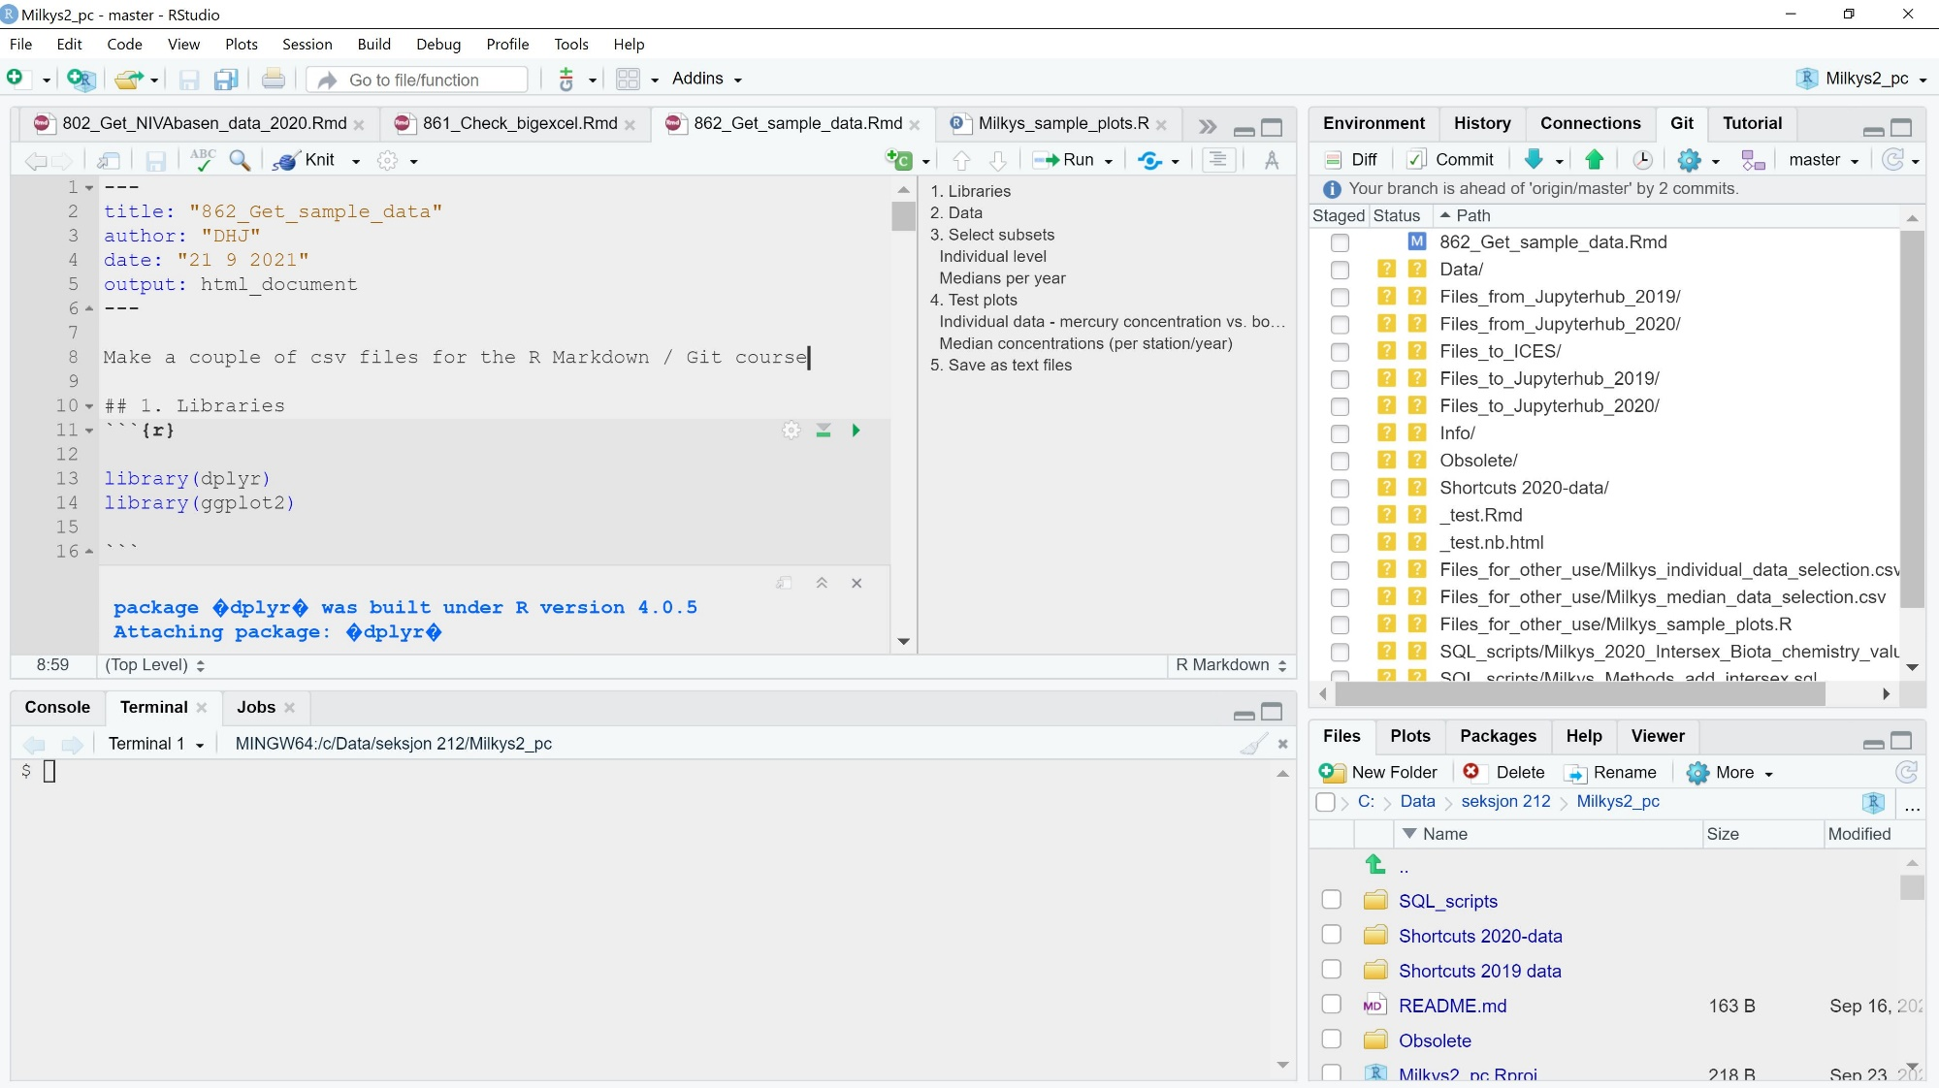
Rstudio’s Git tools
The GIT PANE (only if it’s a GiT PROJECT)
The GIT PANE MENU
A tracked file that has modified (M) but not yet been staged/committed
Lots of untracked files/folders (have never been staged/commited)
The TERMINAL PANE

Slide 14
You don’t have to use Git for all your files
WORKSPACE
LOCAL REPOSITORY
You may not want to track all your files
Temporary scripts
Big data files
These are marked with a yellow questionmark in RStudio - just ignore them
Alternatively, the can be added to a file called .gitignore – then they will disappear for the Git pane
Folder on your computer
Hidden folder on your computer
Tracked files
- have been staged/pulled at least once
- Git notices if the file changes
Script 1
Script 1
Script 2
Script 2
Script 3
Script 3
Data file
Untracked files
- have never been staged/pulled
- Git doesn’t follow it

Slide 15
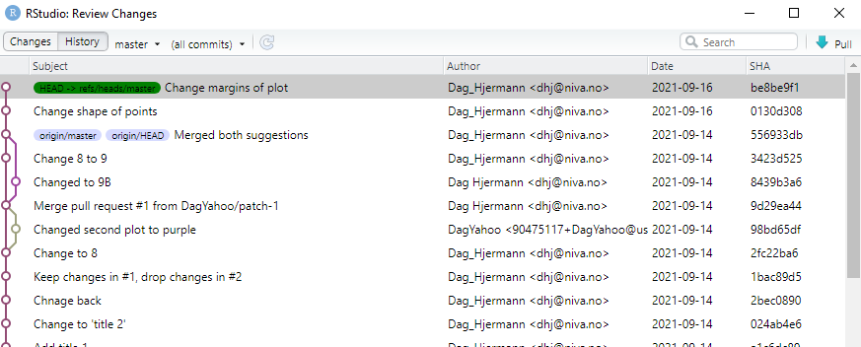
How the history looks like in RStudio
Where you are (2 unpushed commits)
Where Github is
Branching and merging
The name of each commit (SHA-1 hash, used in some commands)
(we will learn more about this later)
Commit messages

Slide 16
Show all this in RStudio

Slide 17
See your repo and its changes in Github

Slide 18
History and commit messages

Slide 19
Add a nice README file

Slide 20
Oh sh*t: different types of «undo»

Slide 21
Git concepts: conflicts

Slide 22
Resolving conflicts in RStudio

Slide 23
Git concepts: branches

Slide 24
Branches in RStudio

Slide 25
Tell Git to ignore some files

